Slide 1


+++ Live +++ +++ Live +++ +++ Live +++
Welcome
to
Software Engineering
Lesson WS2021/2022
Starting at 14:15
survey

Slide 2

+++ Live +++ +++ Live +++ +++ Live +++
The rule No1
Keep your camera on

Slide 3

+++ Live +++ +++ Live +++ +++ Live +++
Software Engineering
WS-2020-2021
Lesson Mo. 14.15-17.45 h Lab: Tue. 14.00-16.00 h
Room 8-103
https://www.linkedin.com/groups/8689804/

Slide 4


Machine Learning
Damir Dobric
Microsoft PTSP (Partner Technical Solution Specialist) Microsoft Most Valuable Professional
Blog
Twitter
damir.dobric@daenet.com b-dadobr@microsoft.com

Slide 5
Machine Learning

Slide 6
What is machine learning?
Finding patterns in data
Replacing human written code with supplying data

Slide 7
Examples
Learn it when you can’t code it (e.g. Recognizing Speech/image/gestures)
Learn it when you can’t scale it (e.g. Recommendations, Spam & Fraud detection)
Learn it when you have to adapt/personalize (e.g. Predictive typing)
Learn it when you can’t track it (e.g. AI gaming, robot control)

Slide 8
AI vs. ML. What is what?
AI
machines can perform tasks characteristic of human intelligence - 1956 by John McCarthy
General AI -> Intelligence
Narrow AI -> Machine Learning
ML
Solves very specific tasks (Image Recognition, Credit Risks, OCR,.. )
Subset of AI

Slide 9
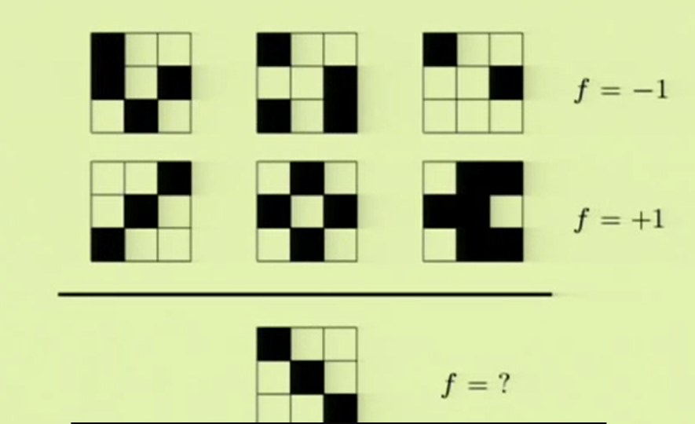
Find function ‘f ’

Slide 10
Finding patterns in data
X | Y
1 | FALSE
9 | TRUE
6 | TRUE
4 | FALSE
8 | TRUE
2 | FALSE
7 | TRUE
3 | FALSE
4 | FALSE
5 | FALSE
10 | TRUE
15 | TRUE
12 | TRUE
X | Y
1 | FALSE
2 | FALSE
3 | FALSE
4 | FALSE
4 | FALSE
5 | FALSE
6 | TRUE
7 | TRUE
8 | TRUE
9 | TRUE
10 | TRUE
12 | TRUE
15 | TRUE

Slide 11
Many problems can be solved by coding
public bool Y(X feature) {
if(feature > 5) return true;
else
return false;
}
X | Y
1 | FALSE
2 | FALSE
3 | FALSE
4 | FALSE
4 | FALSE
5 | FALSE
6 | TRUE
7 | TRUE
8 | TRUE
9 | TRUE
10 | TRUE
12 | TRUE
15 | TRUE
public bool Y(X feature) {
return feature > 5;
}

Slide 12



ML is a different approach
X | Y
1 | FALSE
2 | FALSE
3 | FALSE
4 | FALSE
4 | FALSE
5 | FALSE
6 | TRUE
7 | TRUE
8 | TRUE
9 | TRUE
10 | TRUE
12 | TRUE
15 | TRUE
predict
data
4
clean
transform
maths
model
2
3

Slide 13
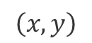
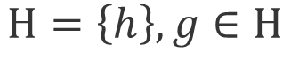
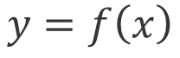
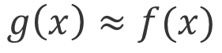
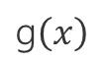

What is learning?
We are looking for function
$$f\left(x\right)$$
$$y=f\left(x\right)$$
g$\left(x\right)$
ML produces hypothesis function g(x)
$$\left(x,y\right)$$
ML
ML Models and algorithms define set of hypothesizes. g(x) is just one of them
$$Η=\left\{h\right\}, g∈Η$$
$$g\left(x\right)≈f(x)$$

Slide 14
Which algorithm to use?
Binary classification
True/false, male/female, high/low, black/white
Multi-class classification
{1,2,3,4}, {A,B,C,D}, {0,1€, 0,5€,1€, 2€}
Regression
1,0-100,00, any real value.

Slide 15
Supervised Learning
Unsupervised Learning
x₂
x₂
x₁
x₁

Slide 16
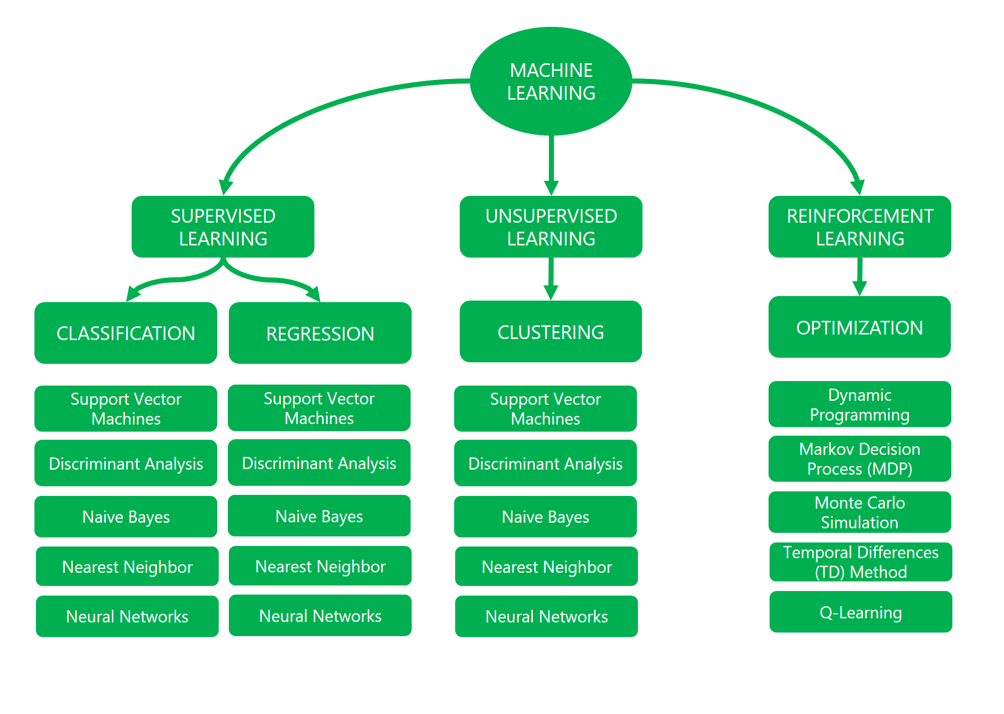

Slide 17
Hierarchical Temporal Memory

Slide 18
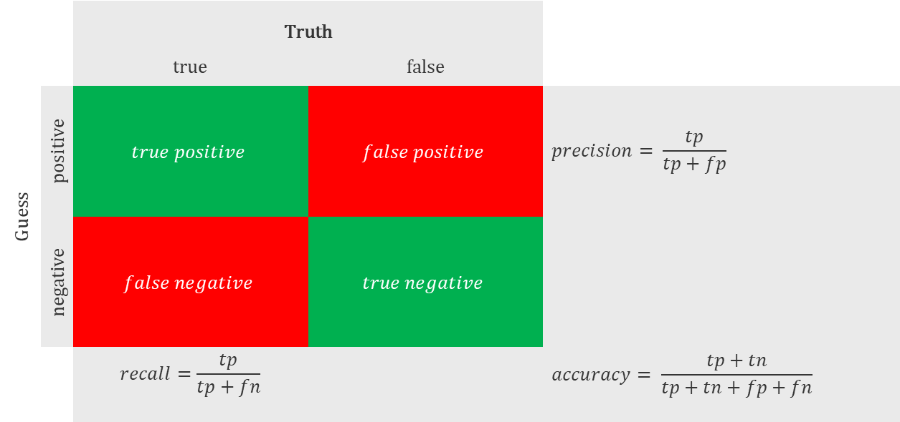
Confusion Matrix
 |  | Truth
 |  | true | false
Guess | positive | $$true positive$$ | $$false positive$$ | $$precision= \frac{tp}{tp+fp}$$
 | negative | $$false negative$$ | $$true negative$$
 |  | $$recall=\frac{tp}{tp+fn}$$ |  | $$accuracy= \frac{tp+tn}{tp+tn+fp+fn}$$

Slide 19
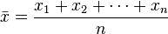
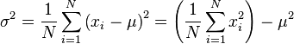
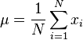
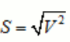
Good to know
Mean
Median separates the higher half of a data from the lower half:
{3, 3, 5, 9, 11} =>5
{3, 5, 7, 9}=>(5 + 7) / 2 = 6
Variance where
Standard Deviation
Square root of the squared variance

Slide 20
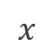
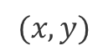
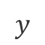
ML Approach
Historical data
$$(x,y)$$
Model Training
Persisted
model
data
$$x$$
Model Evaluation
$$y$$

